Slide 1
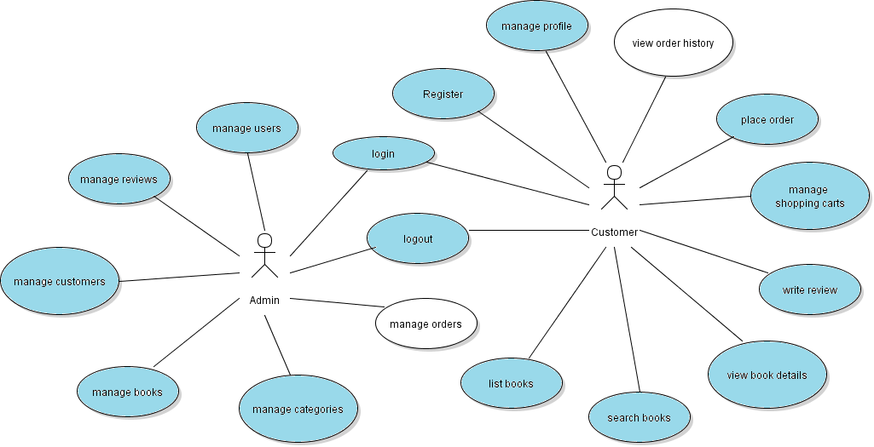
Implement View Order History Feature

Slide 2
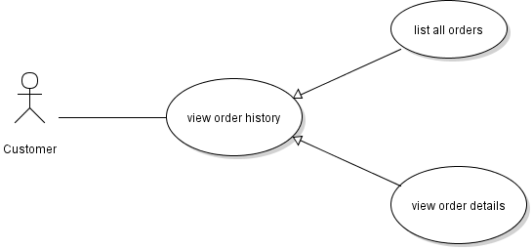
Use Case: View Order History

Slide 3
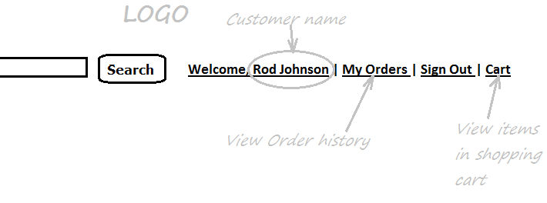
Customer’s Menu

Slide 4
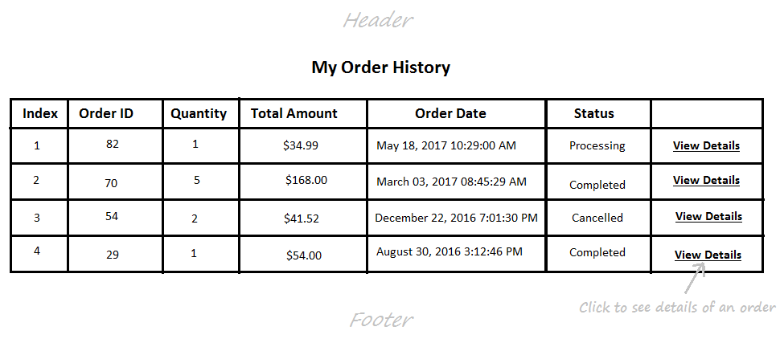
Order History Page

Slide 5
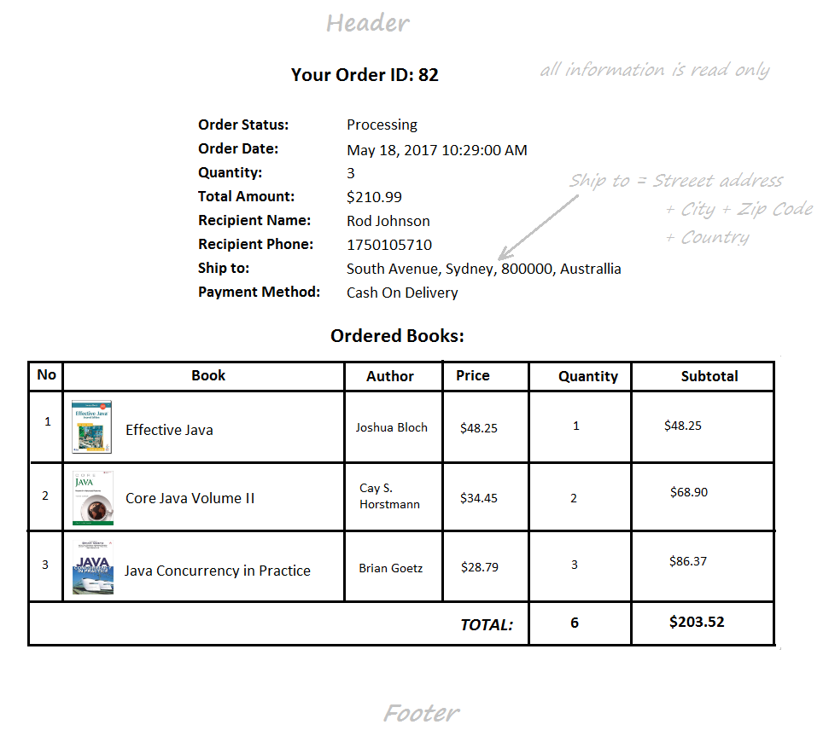
Order Details Page

Slide 6
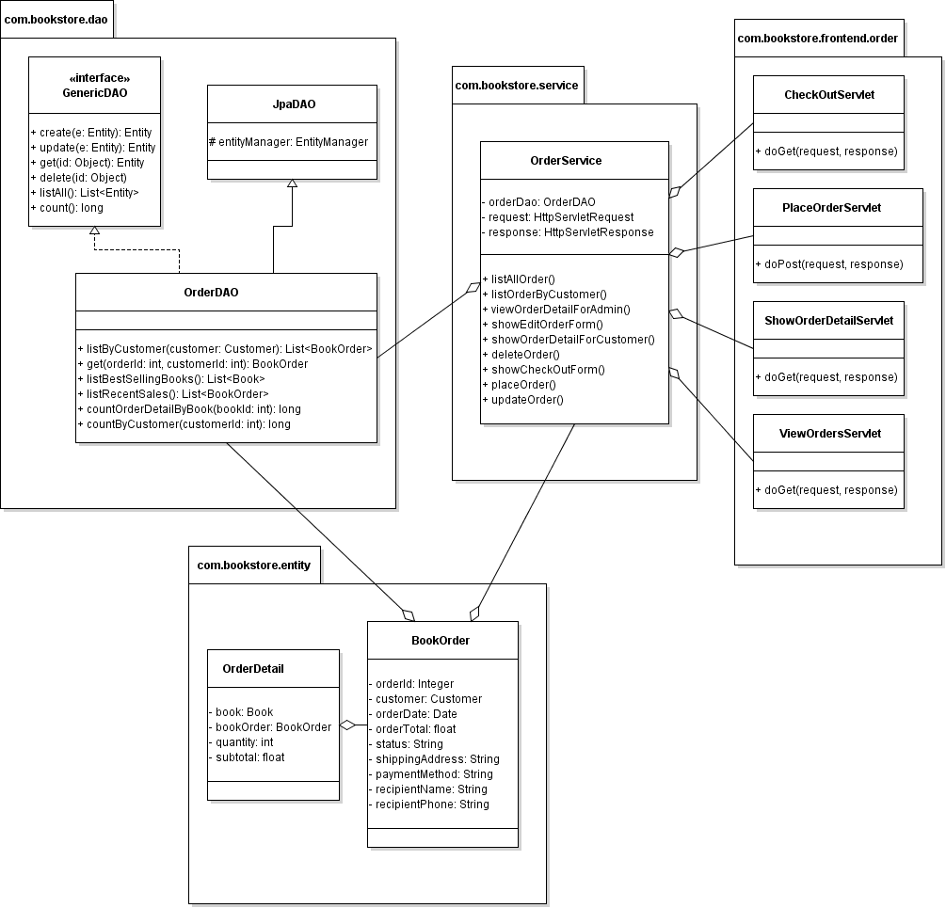
Class Diagram

Slide 7
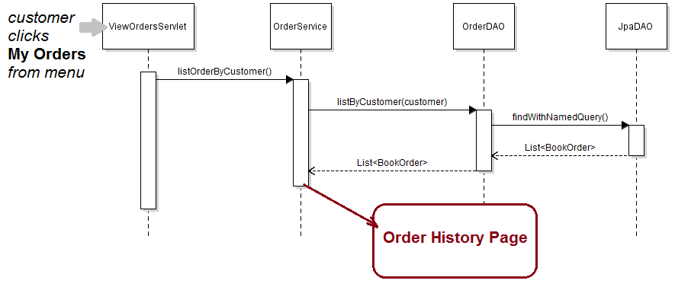
Sequence Diagram: View Order History

Slide 8
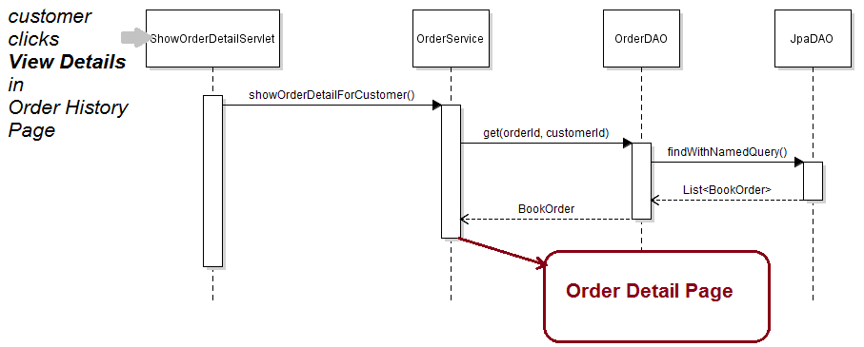
Sequence Diagram: View Order Detail

Slide 9
Implement View Order History Feature
Update OrderDAO + Unit Tests
Create ViewOrderServlet
Update OrderServices
Code Order History Page
Create ShowOrderDetailServlet
Code Order Detail Page
Update CustomerLoginFilter

